Slide 1
HTTP Triggers to manage Snowflake table data
Final Presentation – Data And Analytics Unit
By Gavin Aren
Mentor: Marella Anji Reddy

Slide 2
What are Azure and Snowflake?
Azure
A range of cloud services, including compute, analytics, storage and networking.
I am using Azure Functions, allows me to deploy blocks of code to their server and it is an always-on service so my service will be always be available. I don’t have to worry about any server maintenance, running costs, updates etc.
Snowflake
Cloud based data-warehousing company. Allows you to mobilise data with near unlimited scale, concurrency and great performance.
Separates storage from compute so customers can pay for storage and compute separately, and its cheap

Slide 3

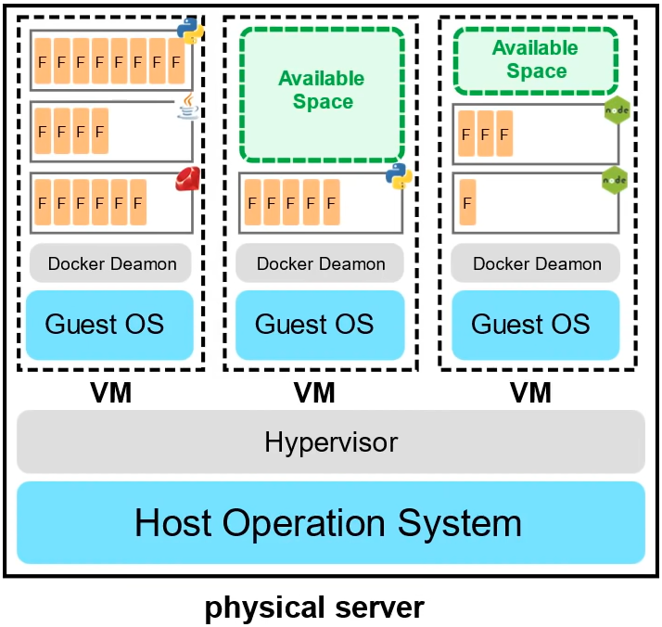
Azure Functions
A managed VM that is running managed containers
Known as Serverless Compute
Only responsible for the code and data, nothing else
Very cost-effective
Source: https://www.youtube.com/watch?v=NKEFWyqJ5XA

Slide 4

Explanation of my project
I am creating HTTP endpoints that trigger a function when given the right parameters.
Meaning, given the right input, the endpoint will trigger some Python code in the back-end, process this input.
I have been making 4 triggers, GET, POST, DELETE and UPDATE (PUT), each of which come with a unique URL to access them. These trigger the appropriate action (such as fetching, adding or deleting data) to a Snowflake table they are connected to.
Finally, to avoid putting the user’s credentials to access the Snowflake table in plaintext in the code, I stored and referenced these credentials using Azure KeyVault

Slide 5
My Workflow Management System

Slide 6
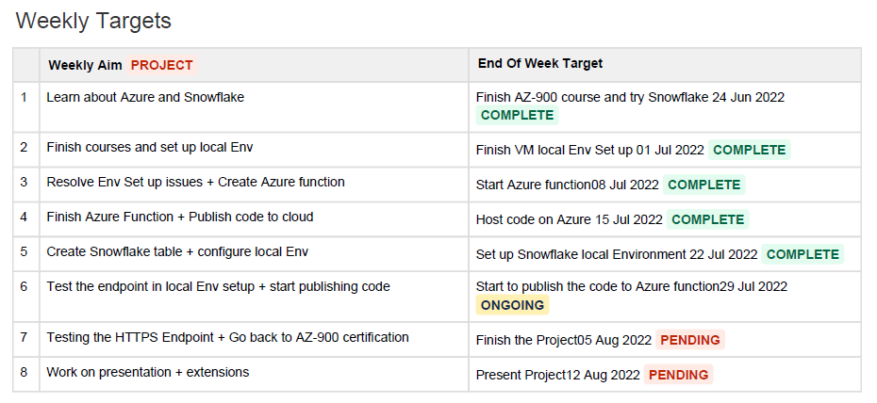
Weekly plan in the 5th week

Slide 7
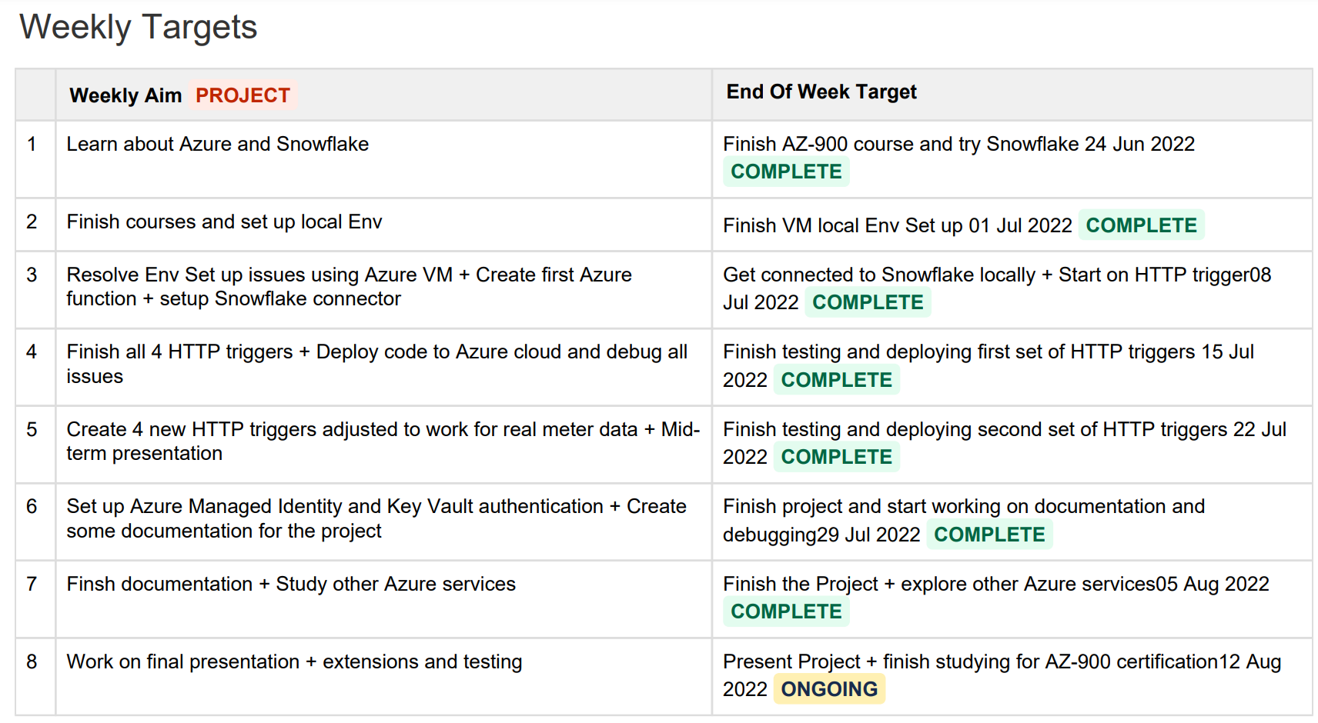
New Weekly Plan (Week 5 onwards)

Slide 8
Real Meter Data Demo with all Triggers

Slide 9
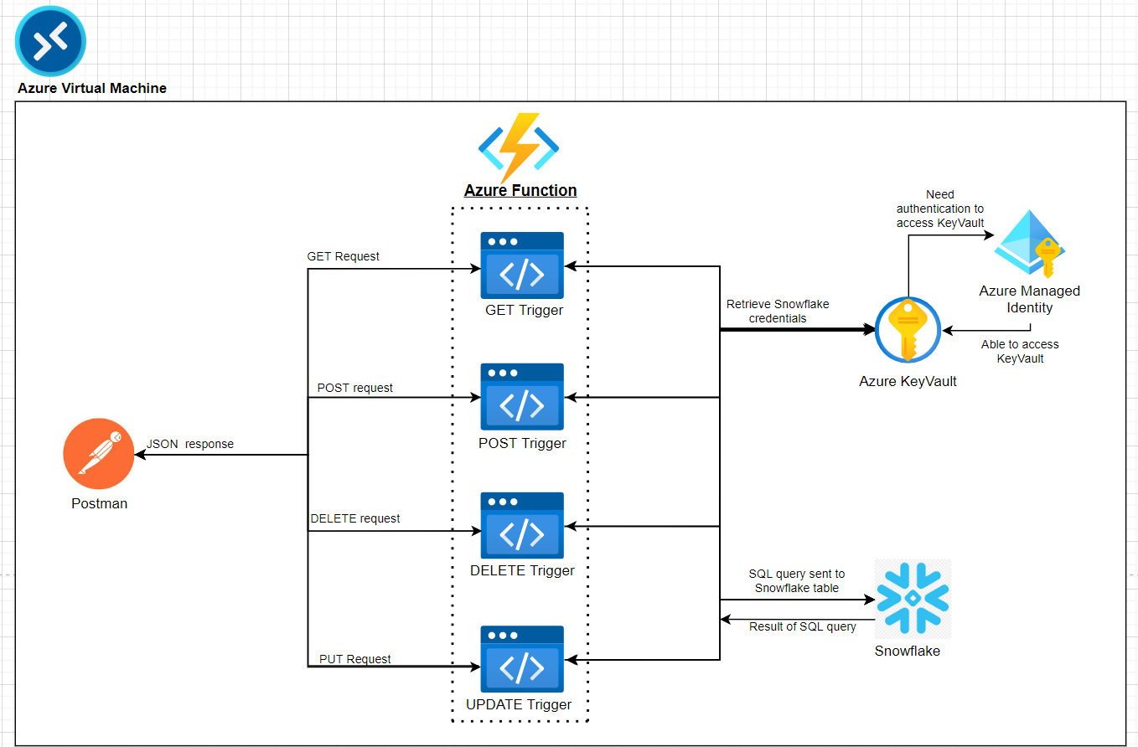
System Architecture Diagram

Slide 10
Brief Look at the Python Solution

Slide 11
Documentation of the Key Steps and Challenges

Slide 12
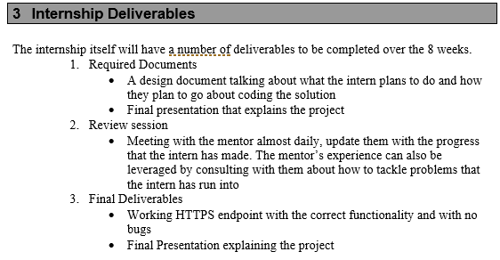
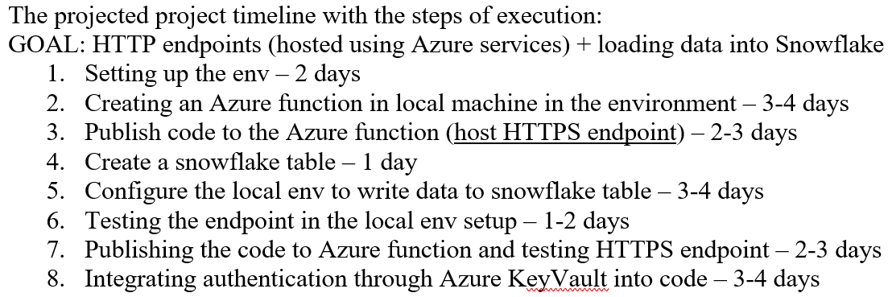

Final Reflection on Workflow doc

Slide 13

Things I have learnt
Programmers must familiarise themselves with using documentation
Professionals must operate with responsibility and set their own deadlines and reflect on it
It is a part of the job to know how to resolve your own technical issues and raise tickets etc.
Enjoyed solving problems on my own, gained confidence, sometimes got a new perspective from Anji on various issues
Exec Lounge talks have been absolutely excellent
Notes:
1)Few times in the project I’ve spent a day just reading lots of documentation and understanding a new software/platform
5) Sanjay Shahay (Digital Marketing)- Everyone has a lot of ideas, but people who are able to execute it and scale it, are going be successful. Ideation is easy, persistence is more important.

Slide 14

Closing thoughts..
I have thoroughly enjoyed working on this project and getting a glimpse of what every-day work might be like in the industry.
I would like to thank all the employees involved with InStep and Infosys for granting me this opportunity and I look forward to applying to work at Infosys after I graduate.

